Slide 1
Defect Detection in Fabric
Computer Vision Hackathon by Prithvi.ai
Team Name:
No Free Lunch
Team Members:
Chirag Goyal
Garvit Garg
Kshitiz

Slide 2
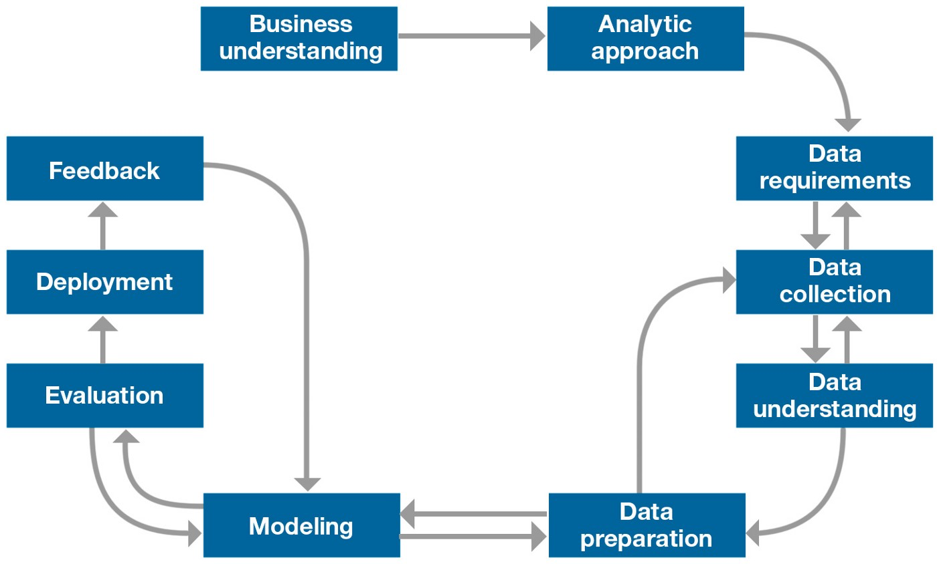
Data Science Approach/Pipeline
Conclusion: Wants Automatic Feature Extraction with not much Data Preparation required. But Why?? 🤔 -> Deep Learning Techniques -> YOLO Algorithm Used

Slide 3
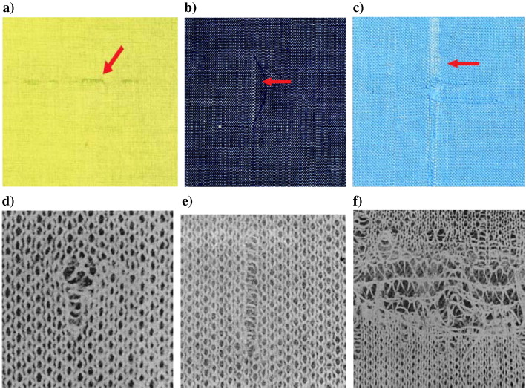
Problem Statement
Goal: Reducing the wastage happening in textile industries due to defects present in the fabrics. Increasing the Profit of a company (Business Objective or Understanding)
Idea: To train an object detection algorithm that tries to maps the image of the fabric either into good and defected and in case of a defected image it gives the position of the defect is being captured in form of a bounding box.

Slide 4
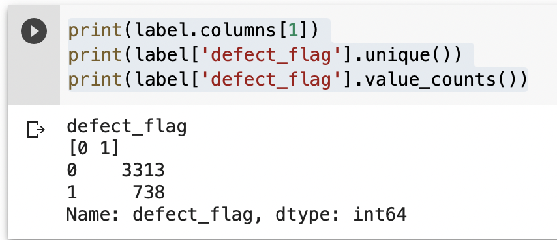
Exploratory Data Analysis Results
What Step next? Data augmentation is the practice of using data we already have to create new training examples to help our machine learning models generalize better.
Why? - Exploratory Data Analysis (EDA)
Observation: Given Training data is imbalance wrt classes, so we have to augment the data and make the data points of both the classes approximately equal otherwise model is biased towards one class and not able to generalize. Objective Defeated !! 😔

Slide 5
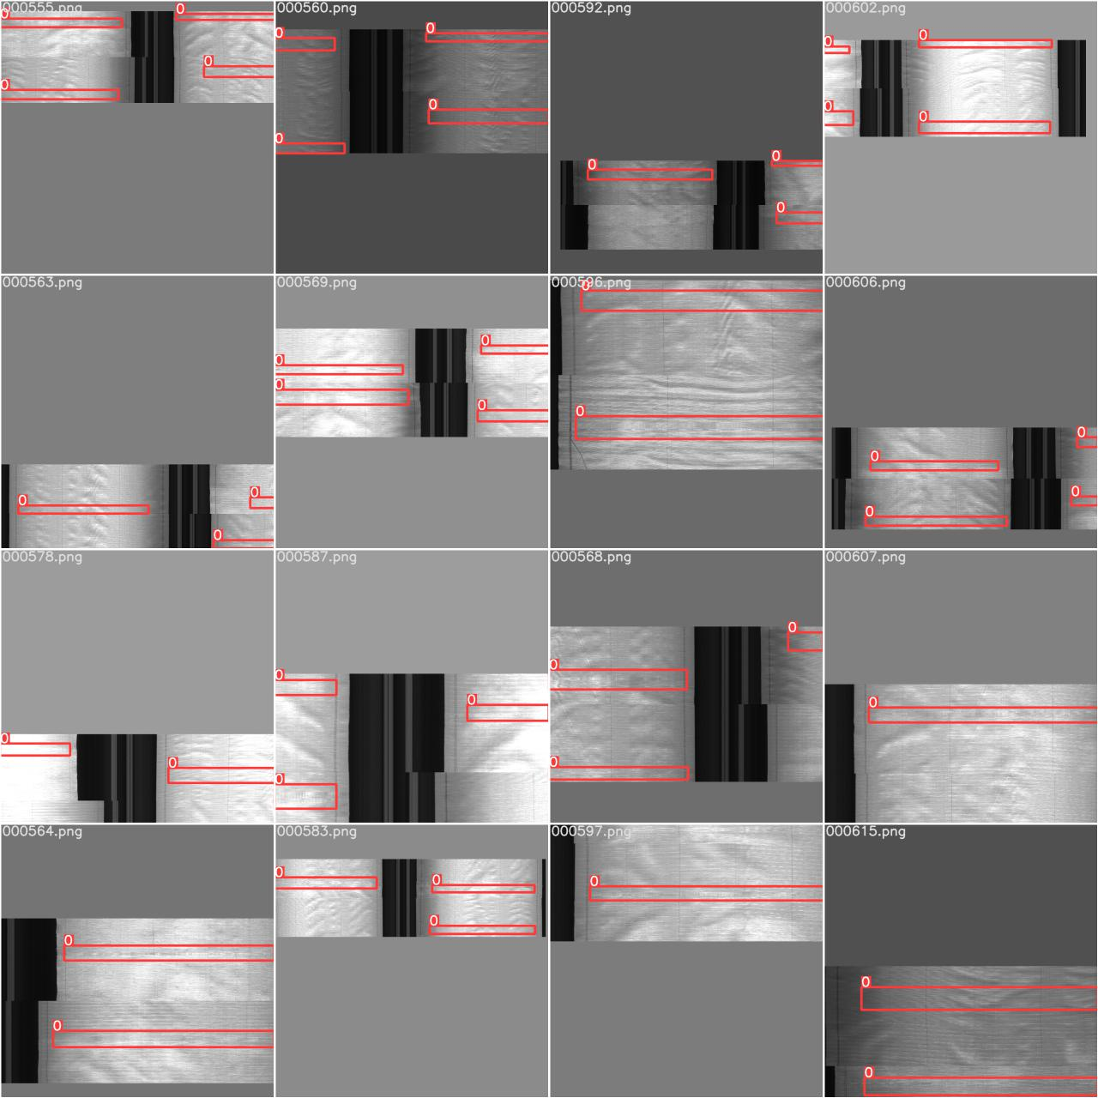
Data Preprocessing Steps
👉 Mosaic: Mosaic augmentation is especially useful for the popular COCO object detection benchmark, helping the model learn to address the well known "small object problem" - where small objects are not as accurately detected as larger objects.
👉 Random Crop: Random crop is a data augmentation technique wherein we create a random subset of an original image. This helps our model generalize better because the object(s) of interest we want our models to learn are not always wholly visible in the image or the same scale in our training data.

Slide 6
👉 Vertical and Horizontal Flip : The image can be flipped either horizontally or vertically based on the object in the image. For some objects we should not flip it vertically as the image may change entirely. The flip transformation below is just for understanding the concept.
👉 Brightness and Saturation: Brightness is an important factor when training the model. We are not sure that the images are always taken in better lighting. So, our model needs to identify the object even with the least resolution.
Saturation can be thought of as the ‘amount’ of color in an image. Use the saturation parameter to control the amount of jitter in saturation, with value from 0 (no change) to 1 (potentially large change). saturation doesn’t specify whether the saturation of the augmented image will be higher or lower, just the potential strength of the effect.
👉 Random Scaling: Random Scaling is a type of image data augmentation where we randomly change the scale the image between a specified range.

Slide 7
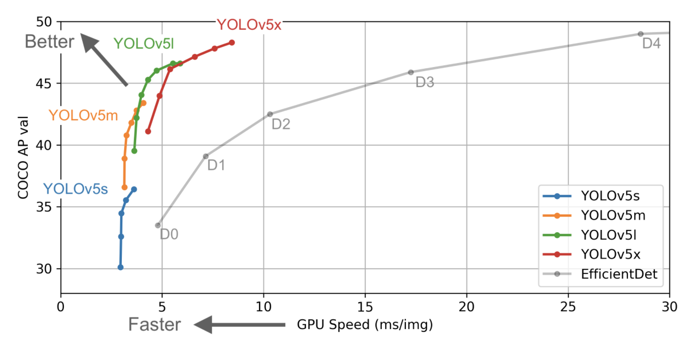
Why YOLO V-5 algorithm?
Algorithm Selection Step in the Data Science Pipeline
Conclusion: The above chart shows preliminary results that YOLO v-5 does exceedingly well to this end relative to other state of the art techniques.

Slide 8
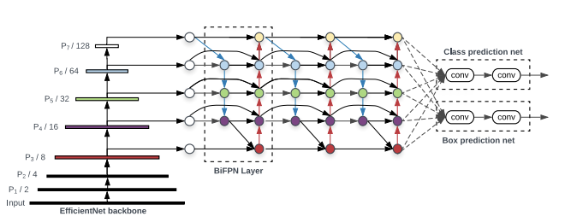
An Overview of the YOLO Architecture
An object detector is designed to create features from input images and then to feed these features through a prediction system to draw boxes around objects and predict their classes.
The YOLO model was the first object detector to connect the procedure of predicting bounding boxes with class labels in an end to end differentiable network.

Slide 9
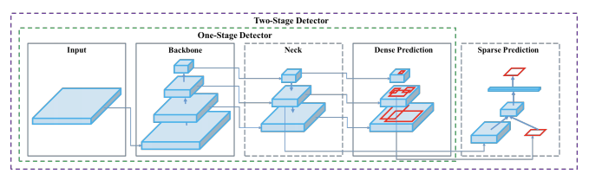
YOLO Architecture
Loss Calculations - YOLO calculates a total loss function from constituent loss functions - GIoU, obj, and class losses. These can be carefully constructed to maximize the objective of mean average precision.

Slide 10
The YOLO network consists of the following three main pieces.
1) Backbone - A convolutional neural network that aggregates and forms image features at different granularities.
2) Neck - A series of layers to mix and combine image features to pass them forward to prediction.
3) Head - Consumes features from the neck and takes box and class prediction steps.
Evaluation Metric: To evaluate object detection models like R-CNN and YOLO, the mean average precision(mAP) is used. The mAP compares the ground-truth bounding box to the detected box and returns a score. The higher the score, the more accurate the model is in its detections.

Slide 11
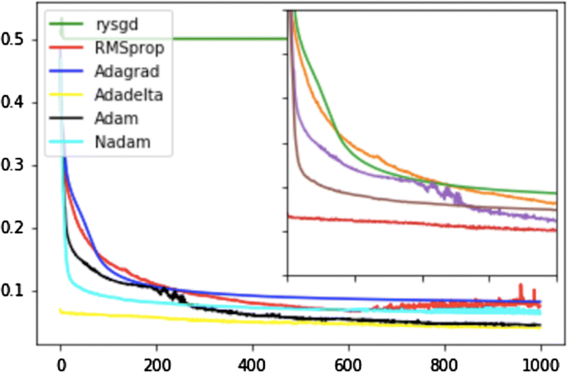
Model Training
Optimizer: ADAM
Loss Function: Cross Entropy Loss
LR Scheduler: One Cycle
Data Augmentation:
Random Scaling
Mosaic
Random Cropping
Vertical and Horizontal Flip
Brightness and Saturation

Slide 12
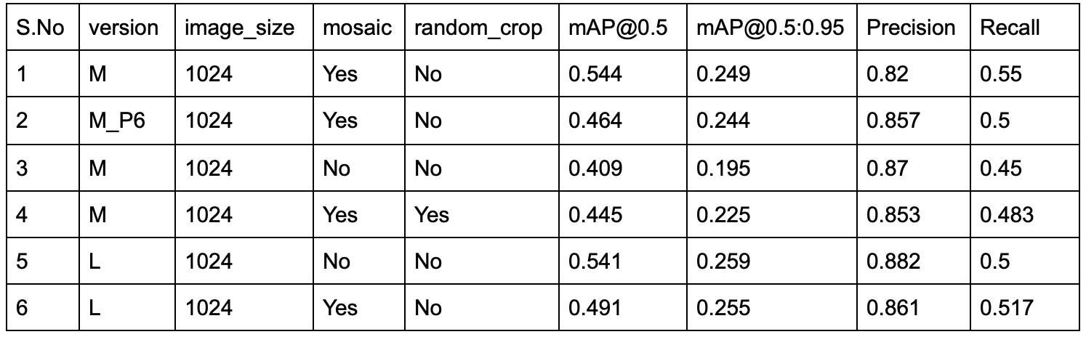
Results-Hyperparameters Tuning
Note: All these results are obtained at confidence threshold = 0.1 and NMS threshold = 0.5

Slide 13
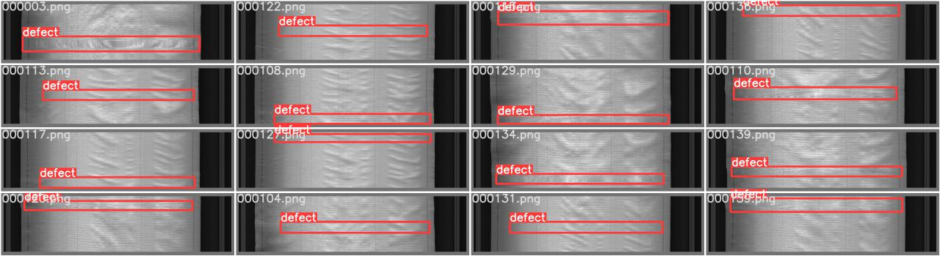
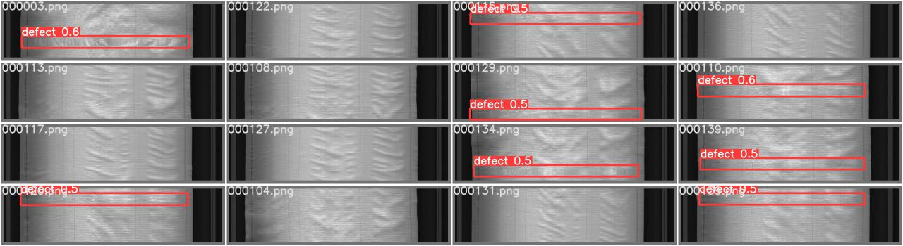
Comparison between the ground truth and model prediction
Ground Truth:
Predicted Results:

Slide 14
Conclusion after trained several models
Best Model:
Based on mAP@0.5 and recall, we can say that the model-1 is the best
Trends Observed During Model Training:
After applying either of Mosaic or Random Crop Data Augmentation technique, we observed that model accuracy decreases and when we not apply these techniques before feeding the data into the model, then the model is not able to generalize well.
Future Research or Development:
As we have observed that the problem of defect in fabric creates a lots of problem either in terms of money or in terms of resource wastage. So, in future we will try or research some other State of the art (SOTA) algorithms like Swin-Transformer, detectron-2, etc and whenever we are able to get the model good in terms of generalization, we will deploy that model using Heroku, AWS, Google Cloud, etc in production so that all textile companies used that model in their cameras and come out of all the problems they are facing with the fabric defection and increase the profit.

